Slide 1

Applied Software Project Management
Estimation

Slide 2
What is estimation?
The project manager must set expectations about the time required to complete the software among the stakeholders, the team, and the organization’s management.
If those expectations are not realistic from the beginning of the project, the stakeholders will not trust the team or the project manager.

Slide 3
Elements of a Sound Estimate
To generate a sound estimate, a project manager must have:
  A work breakdown structure (WBS), or a list of tasks which, if completed, will produce the final product
  An effort estimate for each task
  A list of assumptions which were necessary for making the estimate
  Consensus among the project team that the estimate is accurate

Slide 4
Assumptions Make Estimates More Accurate
Team members make assumptions about the work to be done in order to deal with incomplete information
  Any time an estimate must be based on a decision that has not yet been made, team members can assume the answer for the sake of the estimate
  Assumptions must be written down so that if they prove to be incorrect and cause the estimate to be inaccurate, everyone understands what happened
  Assumptions bring the team together very early on in the project so they can make progress on important decisions that will affect development

Slide 5
Wideband Delphi
Wideband Delphi is a process that a team can use to generate an estimate
  The project manager chooses an estimation team, and gains consensus among that team on the results
  Wideband Delphi is a repeatable estimation process because it consists of a straightforward set of steps that can be performed the same way each time

Slide 6
The Wideband Delphi Process
Step 1: Choose the team
  The project manager selects the estimation team and a moderator. The team should consist of 3 to 7 project team members.
    The moderator should be familiar with the Delphi process, but should not have a stake in the outcome of the session if possible.
    If possible, the project manager should not be the moderator because he should ideally be part of the estimation team.

Slide 7
The Wideband Delphi Process
Step 2: Kickoff Meeting
  The project manager must make sure that each team member understands the Delphi process, has read the vision and scope document and any other documentation, and is familiar with the project background and needs.
  The team brainstorms and writes down assumptions.
  The team generates a WBS with 10-20 tasks.
  The team agrees on a unit of estimation.

Slide 8
The Wideband Delphi Process
Step 3: Individual Preparation
  Each team member independently generates a set of preparation results.
  For each task, the team member writes down an estimate for the effort required to complete the task, and any additional assumptions he needed to make in order to generate the estimate.

Slide 9
The Wideband Delphi Process
Step 4: Estimation Session
  During the estimation session, the team comes to a consensus on the effort required for each task in the WBS.
  Each team member fills out an estimation form which contains his estimates.
  The rest of the estimation session is divided into rounds during which each estimation team member revises her estimates based on a group discussion. Individual numbers are not dicsussed.

Slide 10
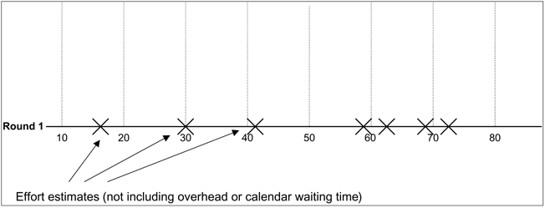
The Wideband Delphi Process
Step 4: Estimation Session (continued)
  The moderator collects the estimation forms and plots the sum of the effort from each form on a line:

Slide 11
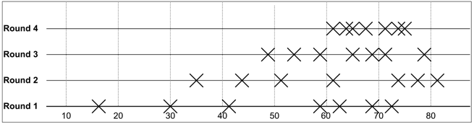
The Wideband Delphi Process
Step 4: Estimation Session (continued)
  The team resolves any issues or disagreements that are brought up.
    Individual estimate times are not discussed. These disagreements are usually about the tasks themselves. Disagreements are often resolved by adding assumptions.
  The estimators all revise their individual estimates. The moderator updates the plot with the new total:

Slide 12
The Wideband Delphi Process
Step 4: Estimation Session (continued):
  The moderator leads the team through several rounds of estimates to gain consensus on the estimates. The estimation session continues until the estimates converge or the team is unwilling to revise estimates.
Step 5: Assemble Tasks
  The project manager works with the team to collect the estimates from the team members at the end of the meeting and compiles the final task list, estimates and assumptions.
Step 6: Review Results
  The project manager reviews the final task list with the estimation team.

Slide 13
Other Estimation Techniques
PROBE, or Proxy Based Estimating
  PROBE is based on the idea that if an engineer is building a component similar to one he built previously, then it will take about the same effort as it did in the past.
  Individual engineers use a database to maintain a history of the effort they have put into their past projects.
  A formula based on linear regression is used to calculate the estimate for each task from this history.
COCOMO II
  In Constructive Cost Model, or COCOMO, projects are summarized using a set of variables that must be provided as input for a model that is based on the results of a large number of projects across the industry.
  The output of the model is a set of size and effort estimates that can be developed into a project schedule.

Slide 14
Other Estimation Techniques
The Planning Game
  The Planning Game is the software project planning method from Extreme Programming (XP), a lightweight development methodology developed by Kent Beck in the 1990s at Chrysler.
  It is a full planning process that combines estimation with identifying the scope of the project and the tasks required to complete the software.
  The Planning Game is highly iterative. The scope is established by having Development and Business work together to interactively write “user stories” written on index cards to describe the scope. Each story is given an estimate of 1, 2 or 3 weeks. This process is repeated continuously throughout the project.

